Slide 1
World Order in Crisis
The Economic Dimension
May 2022
Prof. Rafi Melnick
President
Reichman University, Herzliya

Slide 2
The Era of Globalization
Globalization was very effective in reducing poverty through expanding world trade and economic growth

Slide 3
World Population Living in Poverty 1981 – 2018
(Income less than $ 1.9 dollars per day, Millions)

Slide 4
Advanced Economies Volume of Trade 1980 - 2021 (1980 = 100)

Slide 5
From Globalization back to Nationalism
The transition from globalization to nationalism may have started before the war in Ukraine – Trump (America first) and Brexit (the UK exiting the European Union) and the Pandemic (Problems in supply chains).
The war presents the danger of returning to the world before the fall of the Iron Curtain with a new player China, that for the moment is sitting on the side.
World trade is expected to decline, but on the other hand, competition in basic markets (oil and food) is expected to increase. Consequences are a decline in growth, a rise in poverty, inflation, and social unrest.

Slide 6
Preliminary Growth Data for 2022

Slide 7
GDP Israel, USA, Euro Area and World 2008 – 2021 and Estimate for 2022 Q1 (Rates of Growth, Percent)
World Financial Crisis
World Pandemic Crisis

Slide 8
Price Shocks the Pandemic and The War

Slide 9
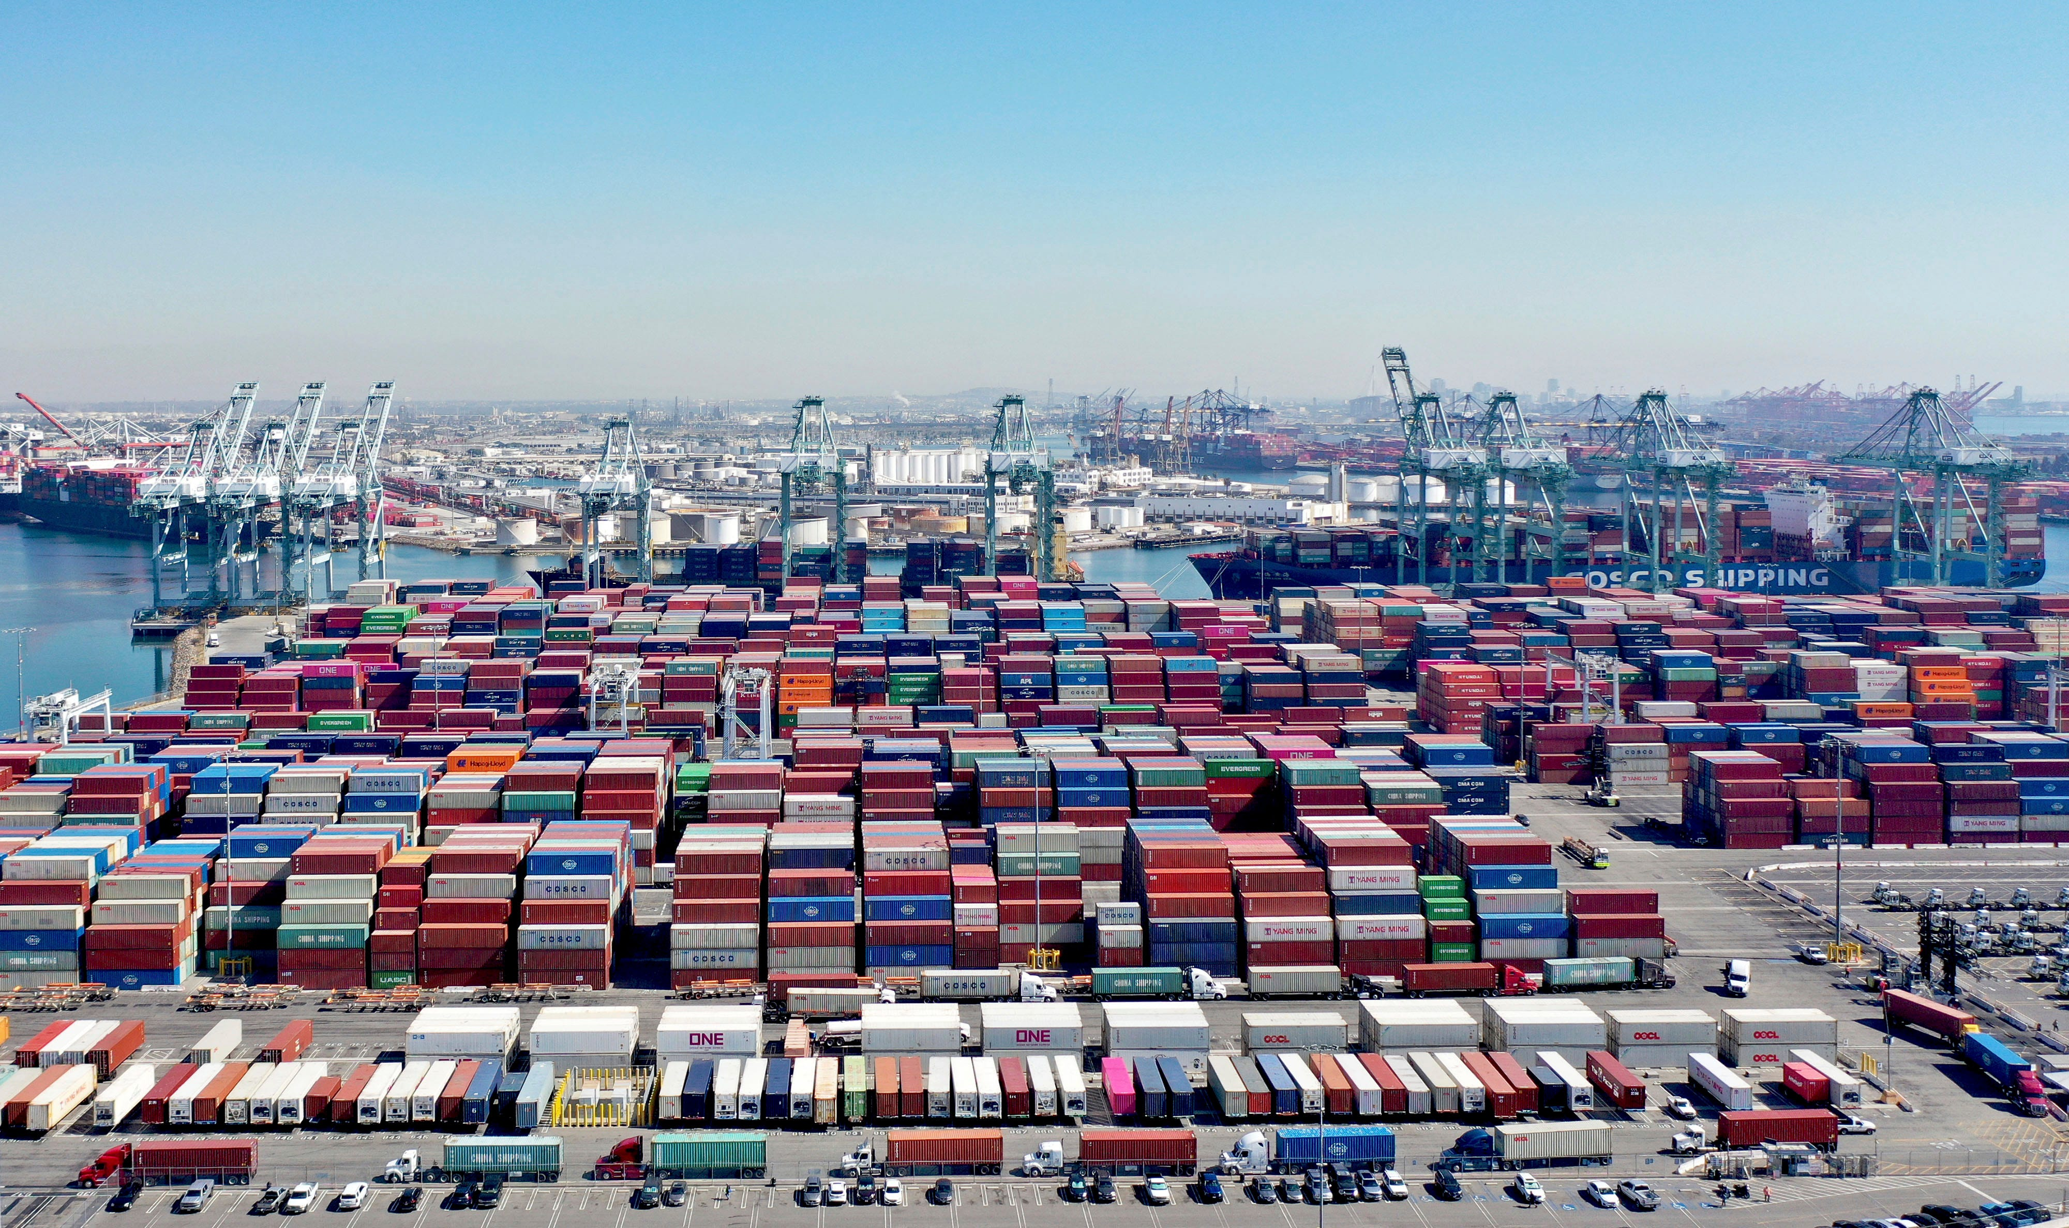
Supply Chain Shortages – The Pandemic shock

Slide 10
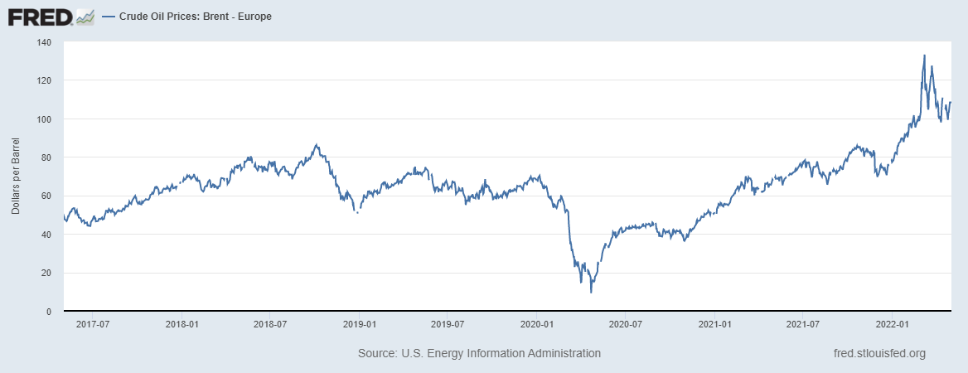
OIL Price Brent Europe 2017 – 2022

Slide 11
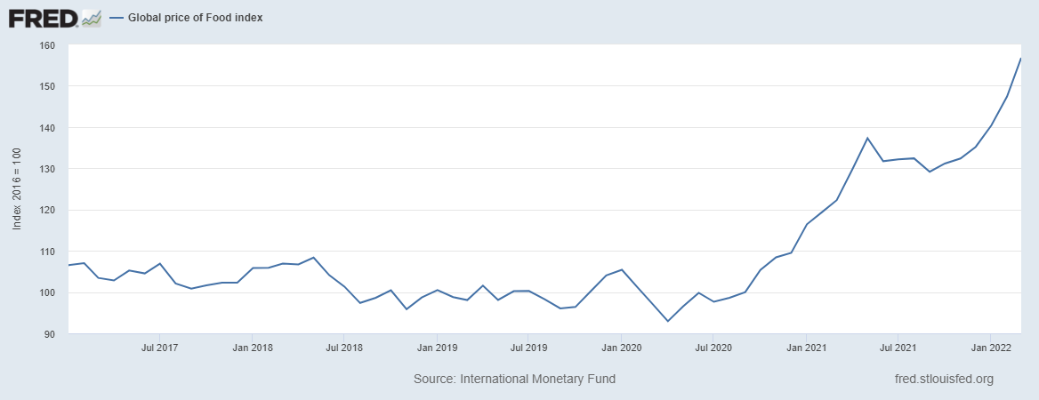
Global Price of Food 2017 - 2022

Slide 12
The Danger of a Perfect Storm – World Recession
Inflation
Monetary Policy – Equilibrating the Rate of Interest
Assets price inflation
The world 2008 financial and the pandemic crises led to a sharp increase in the national debts

Slide 13
Inflation Rates USA, UK, ECB, and Israel
2007 – 2022 (Percent)

Slide 14
Policy Interest Rates USA, UK, ECB, and Israel
2007 – 2022 (Percent)

Slide 15
Inflation and the Fed Interest Rate 2007 – 2022 (Percent)

Slide 16
Inflation and BoI Interest rate 2004 - 2022

Slide 17
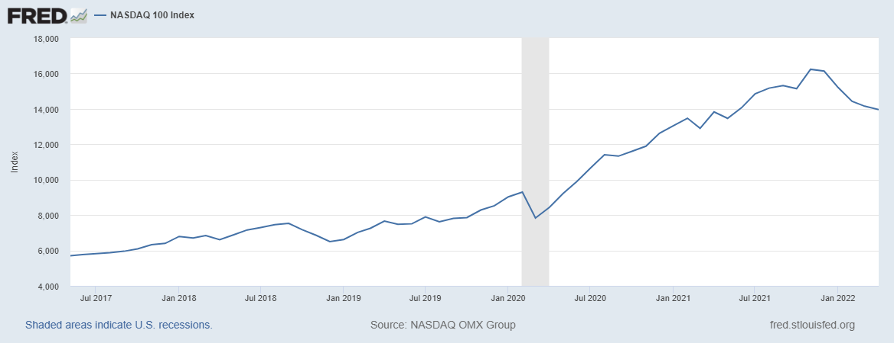
Nasdaq 100 Index Jul 2017 – Apr 2022

Slide 18
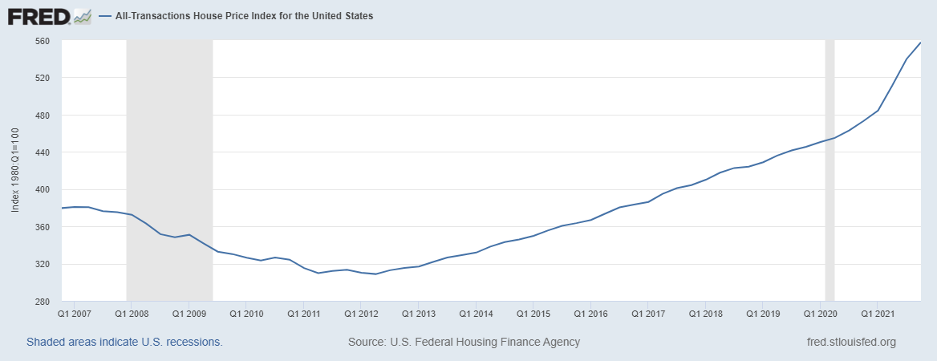
Housing Prices USA 2007 - 2021

Slide 19
Housing Prices in Israel 2000 – 2021
(Annual Percent Change)

Slide 20
General Government Debt 2010-2021
(Percent of GDP)

Slide 21
Thanks

